Slide 1
PSCS_55_Student dropout analysis for school education
CSE7101- Capstone Project
Review-1
Batch Number: CSG-02
Under the Supervision of,
Dr.Chandrasekar V
Professor
School of Computer Science and Engineering
Presidency University
Roll Number | Student Name
20221CSG0075 | KAVYA U P
20221CSG0097 | KAVYA SHREE
20221CSG0109 | BODI LEKHANA
Name of the Program: B.tech Computer Science & Technology (AI & ML)
Name of the HoD: Dr. Anandaraj S.P
Name of the Program Project Coordinator: Dr. Sharmasth Vali
Name of the School Project Coordinators: Dr. Sampath A K , Dr. Geetha A

Slide 2
Content
Problem Statement
Objectives
Background and Related work for title Selection
Analysis of Problem Statement
Innovation or Novel Contributions
Methodology
Git-hub Link
Software requirements
Timeline of the Project
References

Slide 3
Problem Statement Number: 55
Organization : Government of Karnataka
Category (Hardware / Software / Both) : Software
Problem Description: Right to education is key concern for government and at school level; drop out ratio is high due to poverty and social, economic reasons. If government have drop out student analysis on following different categories, it will be very useful in framing different policies. 1. School wise 2. Area wise 3. Gender wise 4. Caste wise 5. Age/standard wise
Expected Output: Focused interventions on the high dropout rates
SDG 1 (No Poverty) Data analytics, AI, and mobile technologies to deliver financial inclusion, aid distribution, and policy planning.
SDG 4 (Quality Education) E-learning platforms, AI-driven personalized learning, MOOCs, and inclusive digital education solutions.
SDG 5 (Gender Equality) Tech-enabled platforms to empower women, promote inclusivity, and eliminate gender bias in algorithms.

Slide 4
Objectives
School-wise analysis - Identify schools with the highest dropout rates, compare performance across government, private, and aided schools.
Area-wise analysis - Map rural vs. urban dropout trends, highlight backward or marginalized regions.
Gender-wise analysis - Track dropout patterns between boys and girls.
Caste-wise analysis - Understand dropout behavior across caste categories (SC/ST/OBC/General).
Age/Standard-wise analysis - Detect critical age groups/grades where dropout rates peak (e.g., transition from primary to secondary), assess correlation between age, learning outcomes, and dropouts.

Slide 5
Background and Related work for title Selection
School dropout has become a serious concern as it directly affects students’ future employment prospects and a country’s literacy rate.
Traditional monitoring methods (like manual observation and attendance tracking) often fail to identify at-risk students early.
Because large amounts of student data are now available, machine learning techniques can be used to analyze key factors and predict dropout risk more accurately and proactively.
Recent research, including the IEEE paper “Machine Learning Based Prediction of School Dropouts” and the GitHub project SCHOOL_DROPOUT_ANALYSIS, demonstrated that models such as Random Forest can effectively predict dropout likelihood using features like attendance, previous academic performance, family income, and parental education.
These studies confirm the potential of machine learning for early identification and motivated the selection of this project topic.

Slide 6
Analysis of Problem Statement
Dropout rates are increasing and have a negative impact on students and society.
Existing methods mainly rely on individual indicators like attendance or exam scores.
Such indicators alone are not sufficient to identify high-risk students early.
Multiple variables (academic, socio-economic and behavioral) influence the decision to drop out.
The availability of student data allows us to analyze all these factors together.
By framing this as a prediction problem, machine learning can be used to identify key contributing factors and accurately predict dropout risk.
This enables educational institutions to take timely action and reduce dropout rates.
Reasons - socio-economic factors, poverty & lack of access to quality education.

Slide 7
Innovation or Novel Contributions
Use of machine learning techniques to analyze dropout risk instead of traditional manual evaluation methods.
Combines multiple factors (academic performance, attendance, socio-economic background, participation, etc.) to provide a more accurate and holistic prediction.
Identification of key contributing factors using feature-importance analysis, which helps institutions focus on the most influential parameters.
Development of an early-warning mechanism that can alert administrators before a student actually drops out.
Potential to be integrated into a decision support system or dashboard for real-time monitoring and intervention.

Slide 8
Methodology
1. Problem Identification - Recognize high dropout rates as a critical barrier to achieving the Right to Education (RTE). Define analysis dimensions: school- wise, area-wise, gender-wise, caste-wise, and age/standard-wise.
2. Data Collection - Government databases (Education Department, UDISE+, NSSO, Census). School records (attendance, enrollment, exam results). Field surveys (family income, socio-economic background, reasons for dropout).
3. Data Preprocessing & Cleaning - Handle missing, duplicate, or inconsistent records, normalize categorical data (e.g., caste, gender coding), remove noise/outliers (e.g., incorrect ages).
4. Data Analysis -
School-wise: Compare dropout rates across institutions.
Area-wise: Identify rural/urban variations, create heatmaps.
Gender-wise: Compare male vs. female dropout trends.
Caste-wise: Analyze dropout distribution among SC/ST/OBC/General.
Age/Standard-wise: Spot critical grades where dropout spikes.

Slide 9
Methodology
5. Predictive Modeling - Use Machine Learning to predict at-risk students.
Algorithms: Random Forest.
Input variables: age, gender, caste, socio-economic background, attendance, academic performance.
Output: Probability score of dropout risk.
6. Visualization - Heatmaps for area-wise dropout, Bar/line charts for gender, caste, and age trends, school ranking by dropout rates.
7. Policy Recommendation Framework - Based on insights, propose interventions such as:
School-level: Remedial classes, teacher training.
Area-level: Transport, infrastructure, digital learning access.
Gender-level: Scholarships for girls, awareness programs.
Caste-level: Inclusive schemes, community engagement.
Age-level: Bridge courses, counseling for secondary transition.

Slide 10
Github Link
https://github.com/BodiLekhana/PSCS_55_Student-dropout-analysis-for-school-education.git

Slide 11
Software requirements:
Data Entry/ Collections : Google Forms / ODK, datasets
Database / Storage : MySQL, Google Sheets, MS Excel
Data Processing & Cleaning : Python(Pandas ,Numpy), R, Excel
Data Analysis & Visualization : Power BI / Tableau, Python(matplotlib, seaborn, plotly), R(ggplot2, Shiny), QGIS)
Statistical & Predictive Analysis : Python (Scikit-learn), R (randomforest), STATA/SPSS.

Slide 12
About Random Forest & it’s features
Random Forest is a supervised machine learning algorithm used for both classification and regression tasks. It is an ensemble learning method that combines multiple decision trees to improve accuracy and reduce overfitting. The algorithm operates by creating a "forest" of decision trees, each trained on random subsets of data and features, and then aggregates their predictions.
Bootstrap Sampling: The algorithm creates multiple subsets of the training data by randomly sampling with replacement. This ensures that each tree is trained on a slightly different dataset.
Random Feature Selection: At each split in a decision tree, only a random subset of features is considered for determining the best split. This reduces correlation between trees and enhances diversity.
Building Decision Trees: Each tree is grown independently using the bootstrapped dataset and selected features. The trees are not pruned, allowing them to grow to their maximum depth.
Prediction Aggregation: For classification, each tree votes for a class, and the final prediction is based on majority voting. For regression, the predictions from all trees are averaged to produce the final output.

Slide 13
Advantages of Random Forest
Reduces Overfitting: By averaging the predictions of multiple trees, Random Forest minimizes the risk of overfitting that is common in individual decision trees.
Handles Missing Data: It can work effectively even with missing values by averaging predictions or using proximity-based imputation.
Feature Importance: Random Forest provides insights into which features are most important for predictions, aiding in feature selection.
Scalability: It performs well on large datasets with many features and can handle both categorical and numerical data.

Slide 14
Algorithm
Create Many Decision Trees: The algorithm makes many decision tree each using a random part of the data. So every tree is a bit different.
Pick Random Features: When building each tree it doesn’t look at all the features (columns) at once. It picks a few at random to decide how to split the data. This helps the trees stay different from each other.
Each Tree Makes a Prediction: Every tree gives its own answer or prediction based on what it learned from its part of the data.
Combine the Predictions: For classification we choose a category as the final answer is the one that most trees agree on i.e majority voting and for regression we predict a number as the final answer is the average of all the trees predictions.

Slide 15
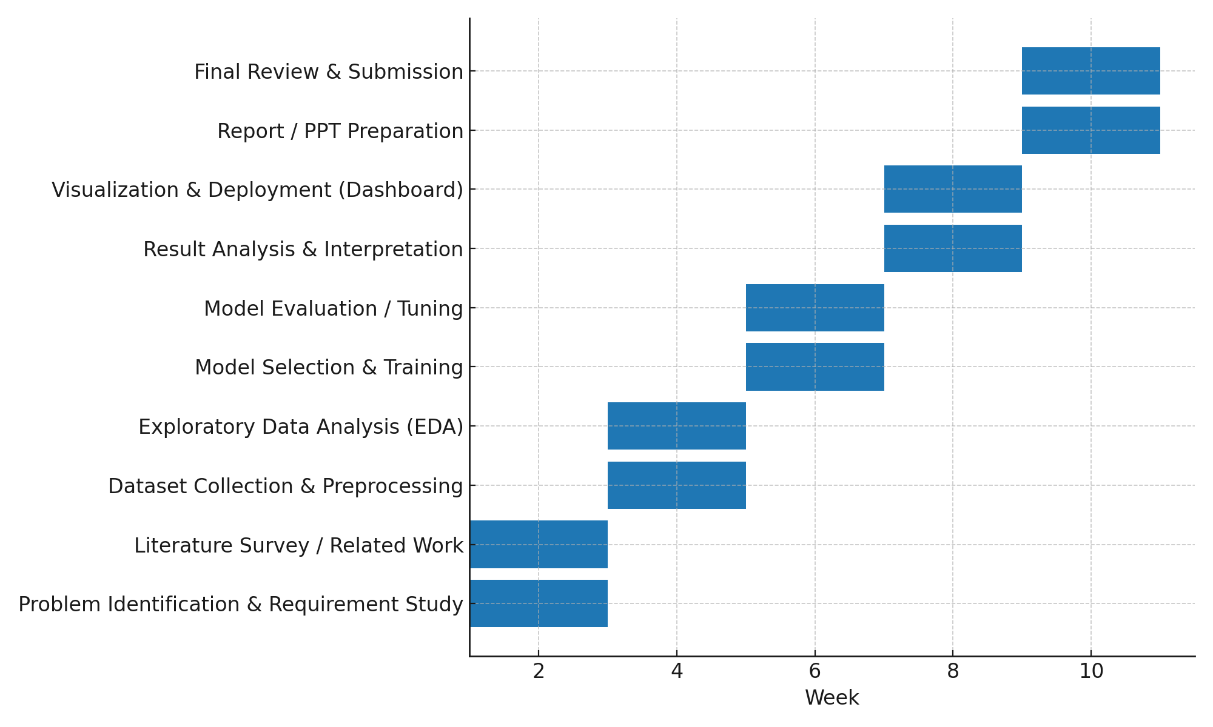
Timeline of the Project (Gantt Chart)

Slide 16
References (IEEE Paper format)
[1] T. Susnjak, “A Prescriptive Learning Analytics Framework: Beyond Predictive Modelling and onto Explainable AI with Prescriptive Analytics and ChatGPT,” arXiv preprint arXiv:2208.14582, 2022. [Online]. Available: https://arxiv.org/abs/2208.14582
[2] J. Park, J. Bae, D. Yoo, and S. Park, “SAICL: Student Modelling with Interaction-level Auxiliary Contrastive Tasks for Knowledge Tracing and Dropout Prediction,” arXiv preprint arXiv:2210.09012, 2022. [Online]. Available: https://arxiv.org/abs/2210.09012
[3] O. Elbouknify, H. Rkha, A. Laaroussi, and A. Bourouhou, “AI-based Identification and Support of At-Risk Students: A Case Study of the Moroccan Education System,” arXiv preprint arXiv:2504.07160, 2025. [Online]. Available: https://arxiv.org/abs/2504.07160
[4] F. Ladeira, A. de Lima, and R. Krohling, “A Visualization Tool for Data Analysis on Higher Education Dropout: A Case Study at UFES,” arXiv preprint arXiv:2201.12637, 2022. [Online]. Available: https://arxiv.org/abs/2201.12637
[5] UNESCO, “2024 Global Education Monitoring Report: Monitoring SDG 4,” Paris, France: United Nations Educational, Scientific and Cultural Organization (UNESCO), 2024. [Online]. Available: https://www.unesco.org/reports/gem-report/en/2024-monitoringsdg4
[6] Government of India (UDISE+), “Unified District Information System for Education Plus (UDISE+),” Ministry of Education, 2025. [Online]. Available: https://udiseplus.gov.in

Slide 17


